Slide 1
AIoT: Artificial Intelligence of Things
AIoT Development Platform for Active Speaker Detection
Yu-Sheng Tzou (鄒雨笙)
National Taiwan University
daniel.tzou1021@gmail.com
Phone: 0928592241
Advisor: Ph.D Chiou-Shann Fuh (傅楸善 博士)

Slide 2
Outline
Introduction
Proposed Method
Expect Result
Summary

Slide 3
Outline
Introduction
Proposed Method
Expect Result
Summary

Slide 4
Introduction: Ipevo Totem 360
Face detection limited to about 2m
IPEVO TOTEM 360 沉浸式會議攝影機
Notes:
這個產品的名字是 IPEVO TOTEM 360，是以愛比科技的品牌作為銷售，價格約兩萬塊新台幣。從外表來看它是一個會議用的攝影機，高約25公分，在頂端有四顆廣角鏡頭，以東西南北四個方向，互相以90度垂直，它目前常使用在視訊會議上。
在這台機器的外殼之下，卻包含著許多的技術，首先是它的影像處理晶片，型號是 AST1220，再來是他的人工智慧晶片。影像處理晶片是由信驊科技 (Aspeed) 所設計；人工智慧晶片是由耐能 (Kneron) 所設計，型號還有待詢問。前著負責如四顆鏡頭影像的實時拼接縫合 (image stitching)，後著負責如人臉的偵測 (face detection)。
關於會議中講者的定位，目前使用的方法是 Direction of Audio(DOA)，從聲音的方向來判定會議中講者的方向，再用人臉偵測將講者框出來。但是當講者和旁邊的人太近時，就會框錯人。
因此，公司希望透過發展人臉嘴型的偵測的人工智慧技術來改善這個問題，因此我們要做的事，就是去發展人臉嘴型偵測的深度學習模型。

Slide 5
Introduction: Ipevo Totem 360
Real-time Image Stitching Problem
4,992 pixels
928 pixels
Panoramic view: 928 × 4,992 pixels
Method: Equirectangular Projection

Slide 6
Introduction
GPU: Graphic Processing Unit
Research Aim:
To develop an Active Speaker Detection system using deep learning model based on the Maxwell GPU system development module Jetson Nano System-on-Module developed by Nvidia.
Notes:
研究目標：發展講者偵測的深度學習模型

Slide 7
Outline
Introduction
Proposed Method
Expect Result
Summary

Slide 8
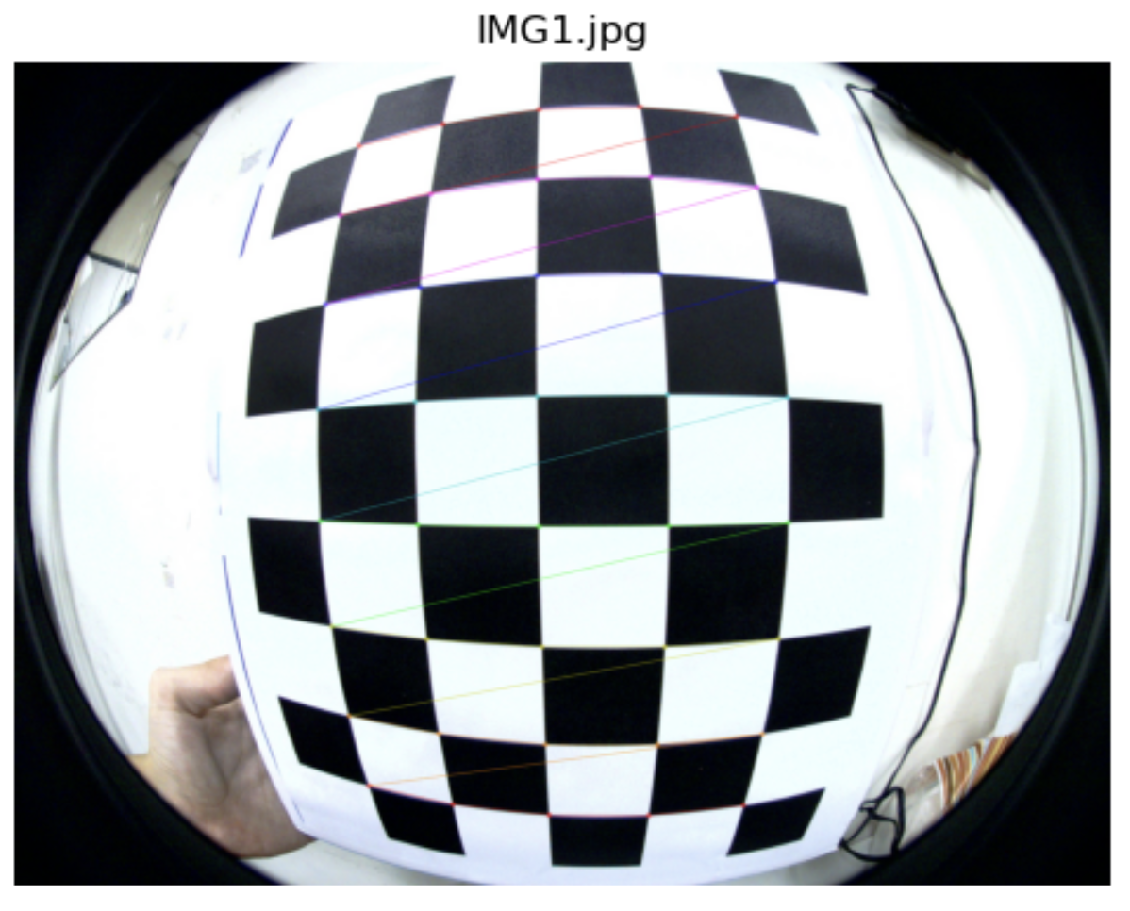
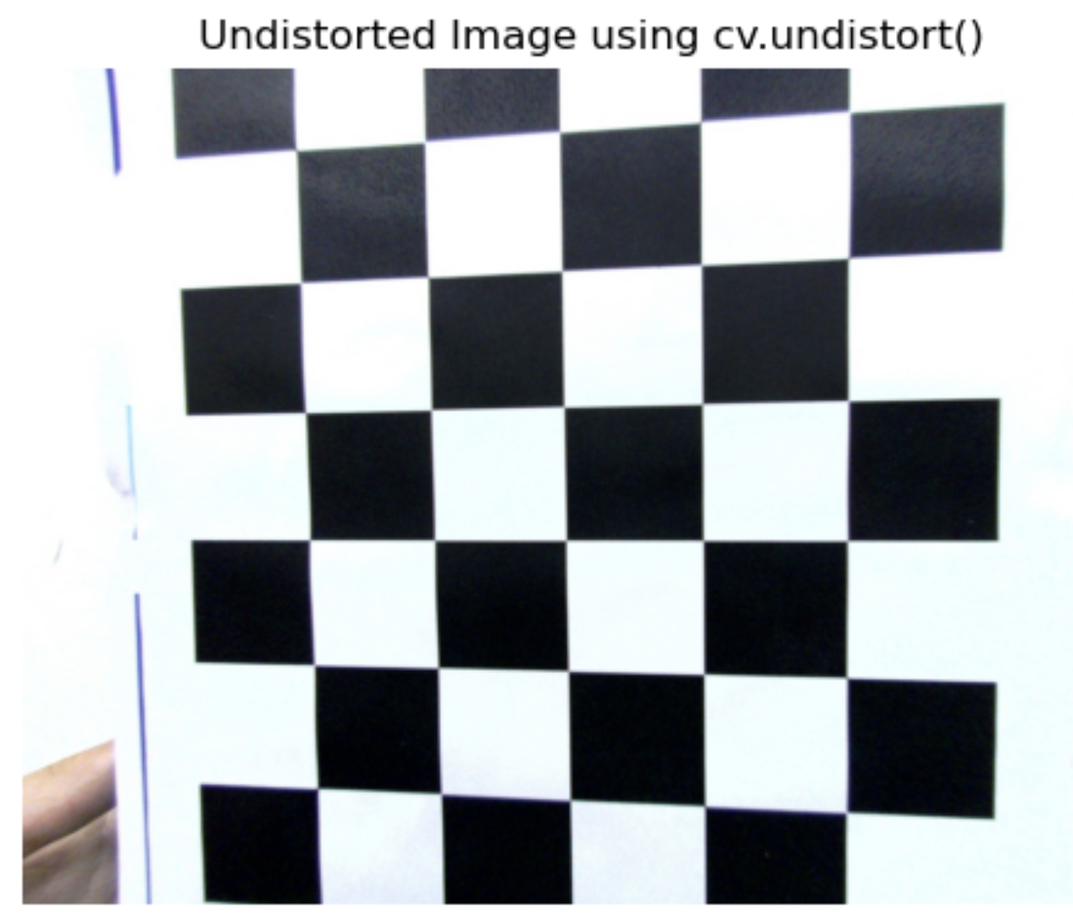
Preliminary: Camera Calibration
Source: https://docs.opencv.org/4.x/dc/dbb/tutorial_py_calibration.html

Slide 9
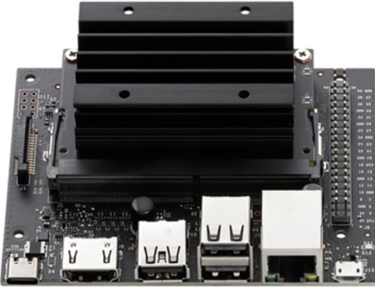
Nvidia Jetson Nano 2GB Developer Kit
CUDA: Compute Unified Device Architecture
GPU: Graphic Processing Unit
ARM: Advanced RISC Machine
RISC: Reduced Instruction Set Computer
CPU: Central Processing Unit
LPDDR: Low-Power Double Data Rate
128-core/CUDA Nvidia Maxwell GPU
Quad-core ARM A57 CPU
2 GB 64-bit LPDDR4 | 25.6 GB/s
Wi-Fi module and cable
Source: https://developer.nvidia.com/embedded/jetson-nano-developer-kit
Notes:
The term "128-core NVIDIA Maxwell GPU" refers to a specific configuration of a graphics processing unit (GPU) developed by NVIDIA, which is based on their Maxwell architecture. Here's a breakdown of the term:
1. **128-core**: This indicates that the GPU contains 128 processing cores. In the context of NVIDIA GPUs, these cores are known as CUDA cores (Compute Unified Device Architecture cores), which are parallel processors that can handle multiple tasks simultaneously. The number of cores is a significant factor in determining the computational power of the GPU.
2. **NVIDIA**: NVIDIA is a well-known company that designs graphics processing units (GPUs) for gaming, professional markets, mobile computing, and automotive market.
3. **Maxwell GPU**: Maxwell is the codename for a GPU architecture developed by NVIDIA as the successor to their Kepler architecture. It was introduced around 2014. Maxwell architecture brought improvements in power efficiency and performance per watt consumed compared to its predecessors.
4. **GPU (Graphics Processing Unit)**: A GPU is a specialized electronic circuit designed to rapidly manipulate and alter memory to accelerate the creation of images in a frame buffer intended for output to a display device. While they are essential for rendering graphics, GPUs are also used for compute-intensive tasks in scientific computing, data centers, machine learning, and more due to their highly parallel structure.
In summary, a "128-core NVIDIA Maxwell GPU" is an NVIDIA-produced GPU that contains 128 CUDA cores and is built on the Maxwell architecture, known for its efficiency and computational ability. This type of GPU would be used for a variety of applications, ranging from graphic rendering to more compute-heavy tasks like deep learning inference.
The term "Quad-core ARM A57 CPU" describes a central processing unit (CPU) based on a specific configuration and architecture. Here's the breakdown of the term:
1. **Quad-core**: This indicates that the CPU has four cores. A core is an individual processing unit within the CPU, capable of executing a series of instructions. A quad-core CPU can handle more tasks at once compared to a single-core or dual-core CPU, as each core can process its own thread independently.
2. **ARM**: ARM Holdings is a company that designs microprocessor technology. ARM itself doesn't manufacture CPUs but licenses its designs to other companies, which fabricate the CPUs. ARM architecture is known for its power efficiency, which makes it the preferred choice for mobile devices, embedded systems, and increasingly for servers and desktops as well.
3. **A57**: This refers to the ARM Cortex-A57 processor, which is one of the ARMv8-A 64-bit CPUs. The Cortex-A57 design is focused on providing a balance between performance and power efficiency, making it suitable for high-end mobile devices and other computing environments where those attributes are desirable.
4. **CPU (Central Processing Unit)**: A CPU is the primary component of a computer that performs most of the processing inside a computer. To use the computer metaphor, the CPU is often referred to as the "brains" of the computer as it executes instructions from programs.
In essence, a "Quad-core ARM A57 CPU" is a CPU with four processing cores using ARM's Cortex-A57 architecture, which is efficient and powerful enough to handle a variety of computing tasks. This kind of CPU is commonly found in devices where efficiency and performance are important, such as smartphones, tablets, embedded systems, and even some low-power servers.

Slide 10
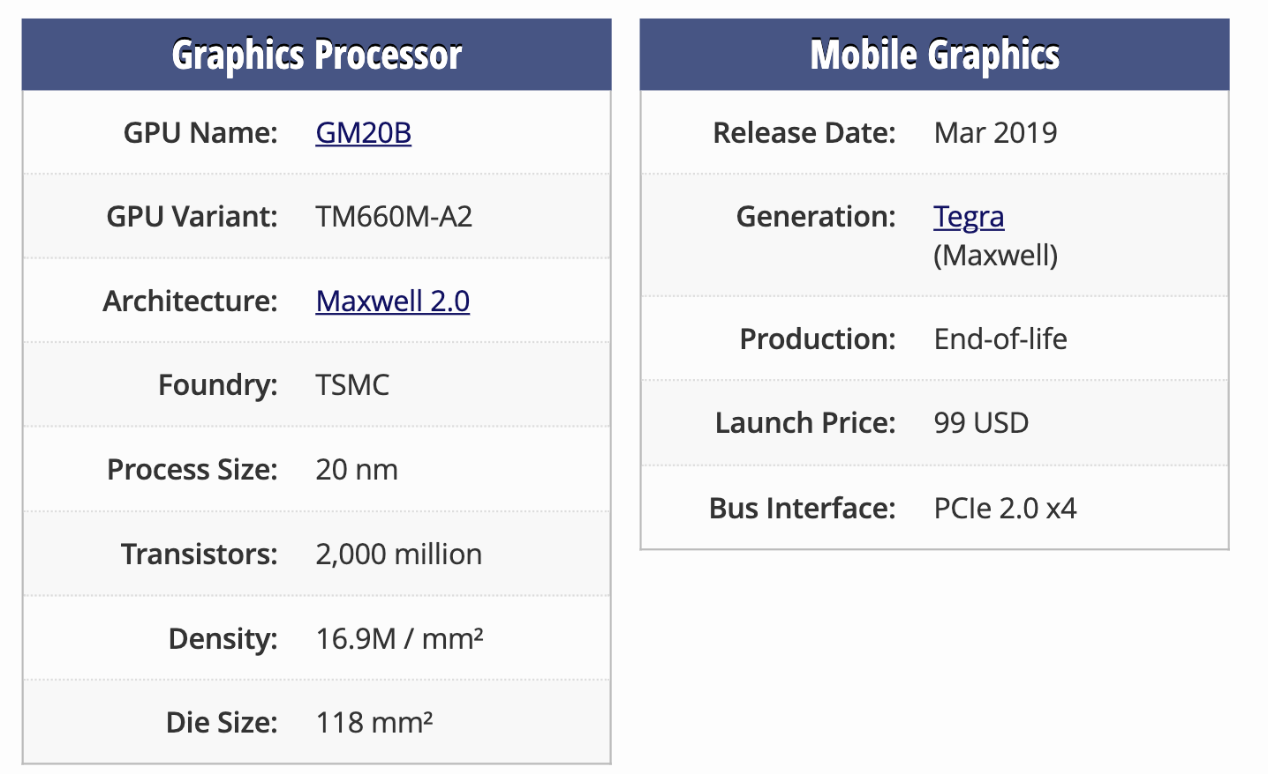
Nvidia Jetson Nano 4GB Developer Kit
Source: https://www.techpowerup.com/gpu-specs/jetson-nano.c3643

Slide 11
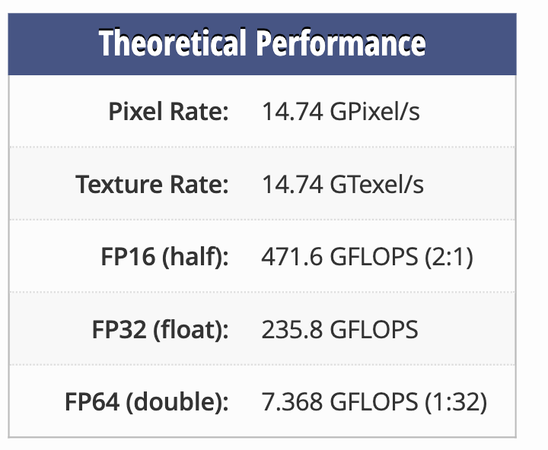
Nvidia Jetson Nano 4GB Developer Kit
GFLOPS: Giga FLoating points of Operation Per Seconds
FP: float
Source: https://www.techpowerup.com/gpu-specs/jetson-nano.c3643

Slide 12
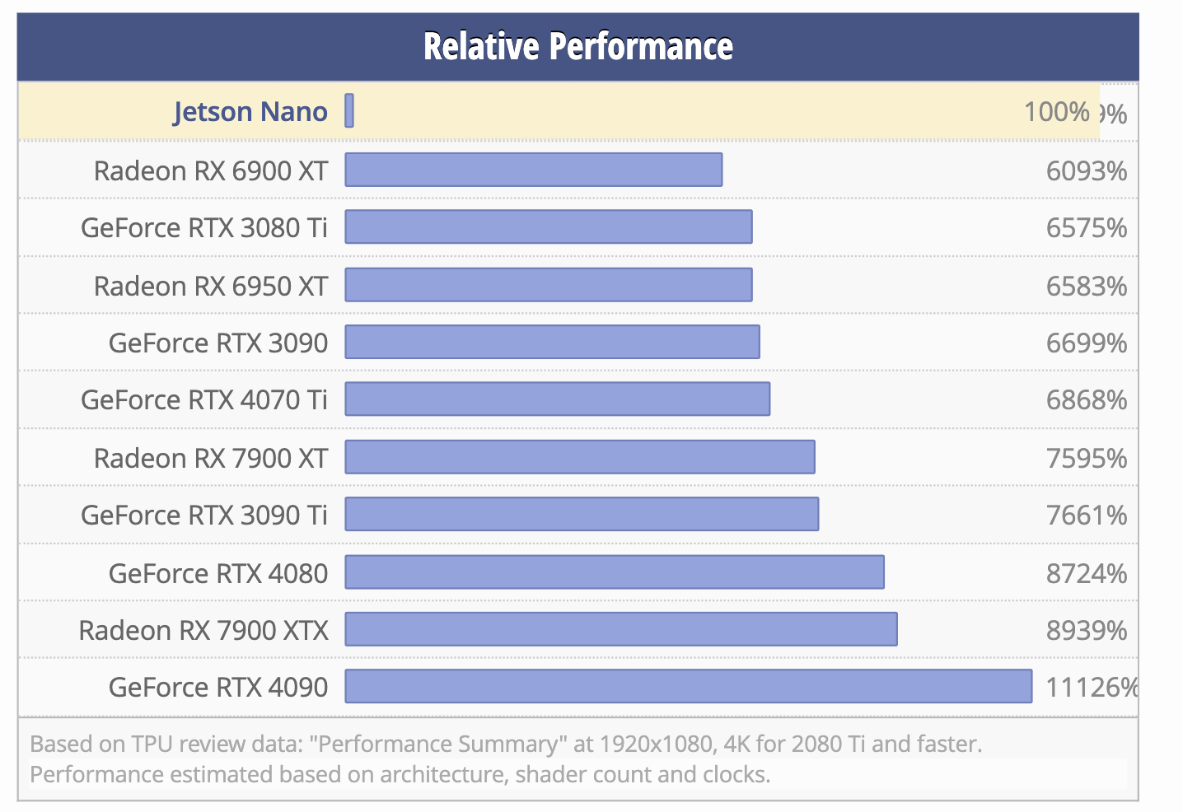
Nvidia Jetson Nano 4GB Developer Kit
Source: https://www.techpowerup.com/gpu-specs/jetson-nano.c3643

Slide 13
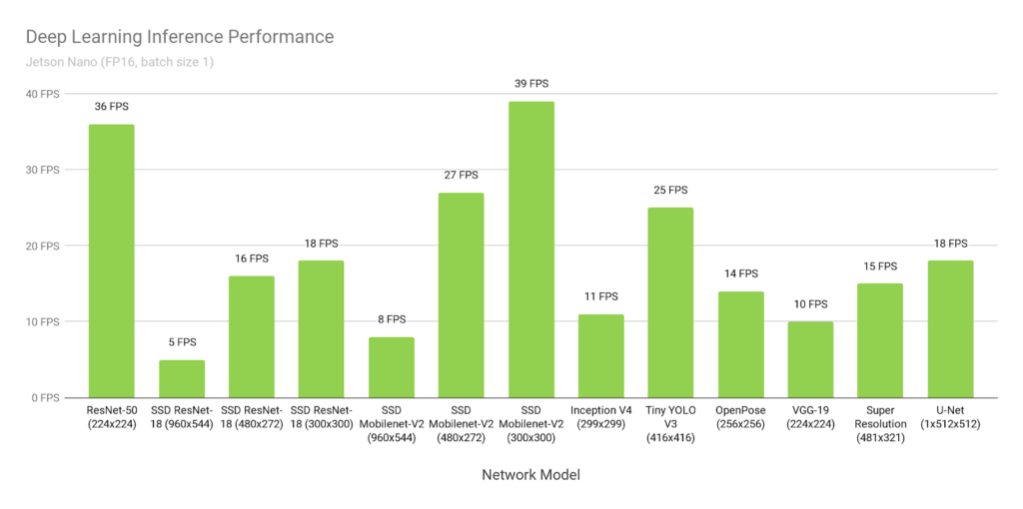
Nvidia Jetson Nano 4GB Developer Kit
FPS: Frame Per Seconds
Source: https://blog.cavedu.com/2019/03/19/nvidia-jetson-nano/

Slide 14
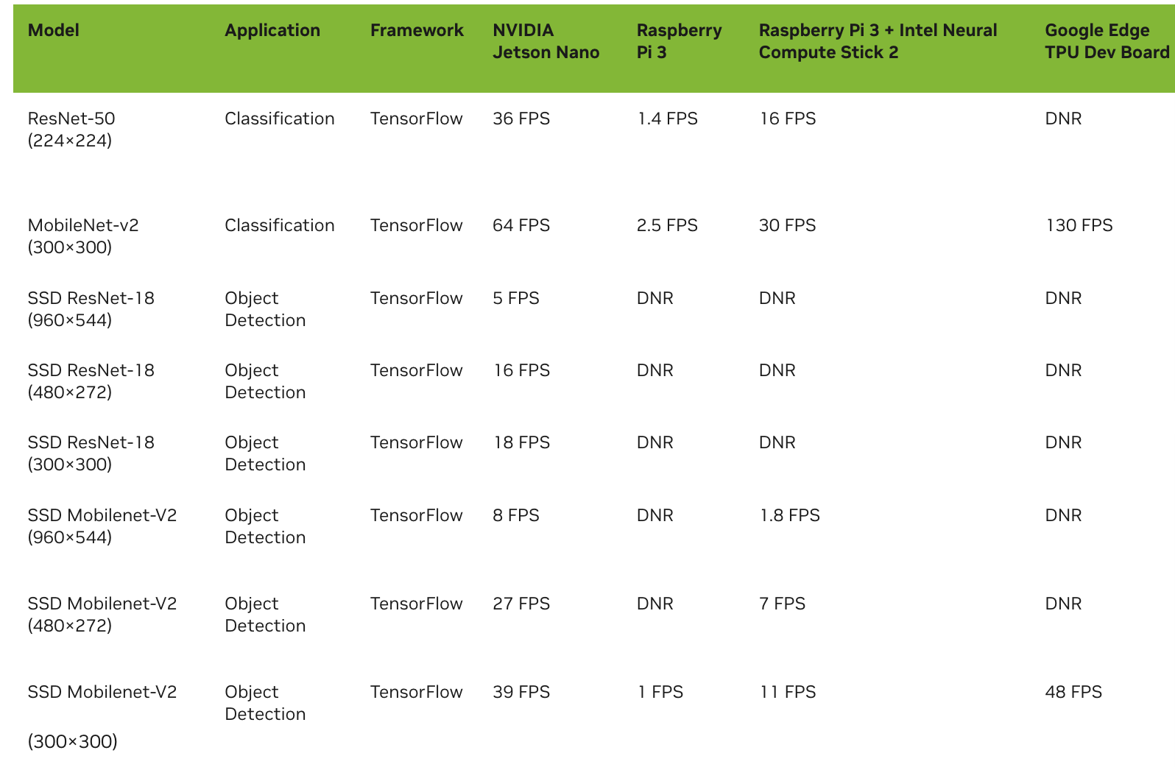
Nvidia Jetson Nano 4GB Developer Kit
DNR: Did Not Run
Source: https://developer.nvidia.com/blog/jetson-nano-ai-computing/

Slide 15
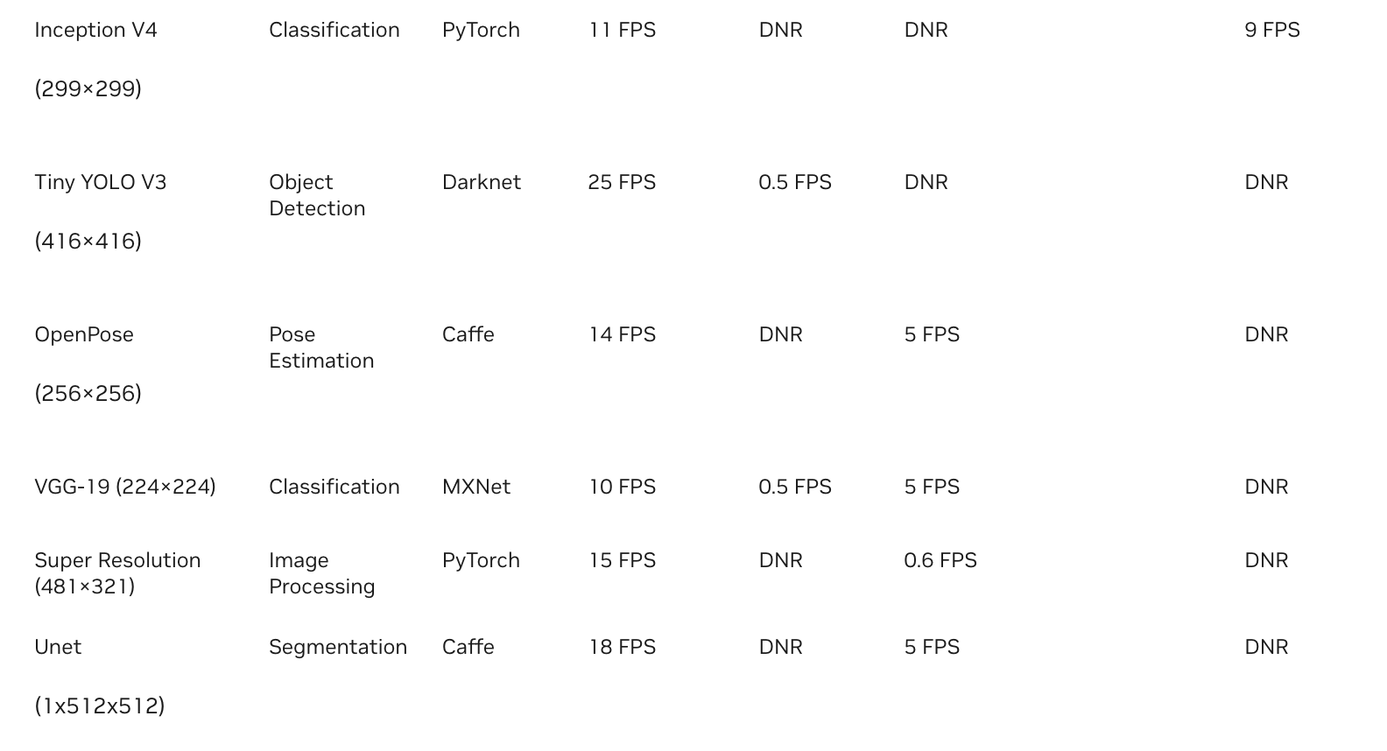
Nvidia Jetson Nano 4GB Developer Kit
Source: https://developer.nvidia.com/blog/jetson-nano-ai-computing/

Slide 16
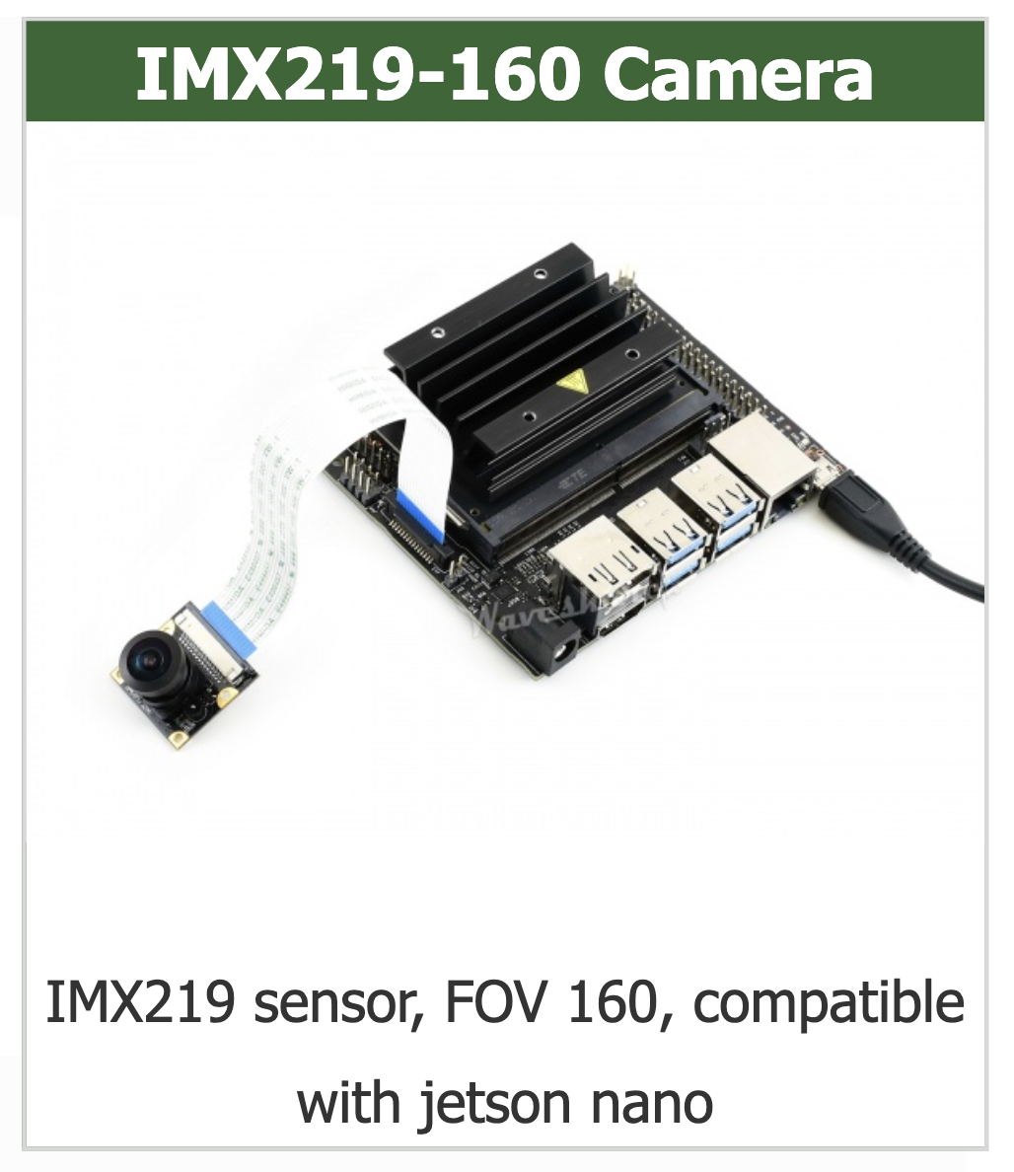
Nvidia Jetson Nano 2GB Developer Kit
FOV: Field Of View
CMOS: Complementary Metal-Oxide-Semiconductor
IMX219-160 Camera:
8,000,000 pixels
Sensor: IMX219
Resolution: 3,280 × 2,464 pixels
Lens specifications:
CMOS size: 1/4inch
Aperture (F): 2.35
Focal Length: 3.15mm
Angle of View (diagonal): 160 degree
Distortion: <14.3%
Dimension: 25mm × 24mm
Source:https://www.waveshare.com/imx219-160-camera.htm
Notes:
研究目標：發展講者偵測的深度學習模型

Slide 17
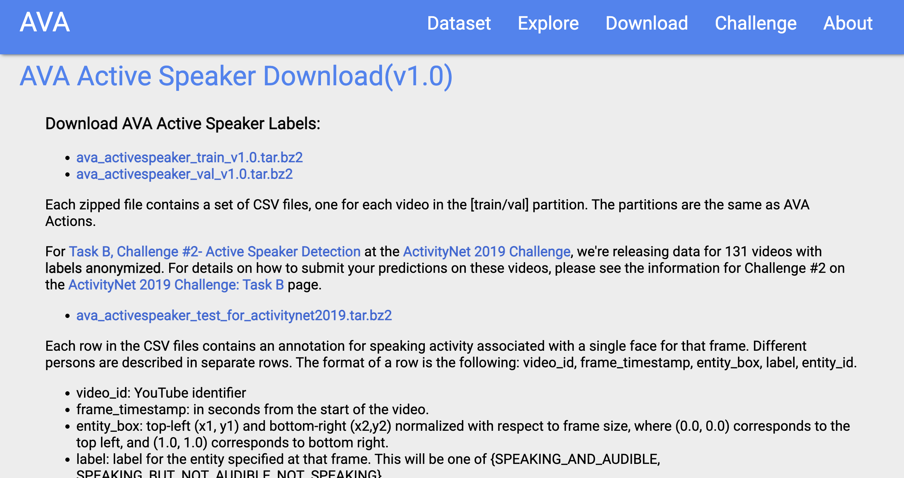
Datasets
AVA-ActiveSpeaker datasets
Source: https://research.google.com/ava/download.html#ava_active_speaker_download
Notes:
The AVA-ActiveSpeaker dataset [33] is the first large-scale standard benchmark for active speaker detection.
It consists of 262 Hollywood movies, of which, 120 are training sets, 33 are validation sets, and the remaining 109 are test sets.
The entire dataset contains nor- malized bounding boxes for 5.3 million faces, and each face detection is assigned a speaking or nonspeaking label.
As a mainstream benchmark for active speaker detection tasks, this dataset contains occlusions, low-resolution faces, low- quality audio, and various lighting conditions that render it highly challenging.
Note that the test set is provided for the ActivityNet challenge and is unavailable. Therefore, herein, the performance of the validation set is evaluated in a man- ner similar to that in previous studies
出處：
Joseph Roth, Sourish Chaudhuri, Ondrej Klejch, Rad- hika Marvin, Andrew Gallagher, Liat Kaver, Sharadh Ramaswamy, Arkadiusz Stopczynski, Cordelia Schmid, Zhonghua Xi, et al. Ava active speaker: An audio-visual dataset for active speaker detection. In ICASSP 2020-2020 IEEE International Conference on Acoustics, Speech and Signal Processing (ICASSP), pages 4492–4496. IEEE, 2020.

Slide 18
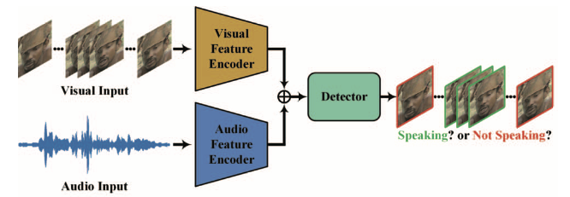
Framework
Overview of the proposed lightweight framework
Source: J. Liao et al., "A Light Weight Model for Active Speaker Detection," 2023 IEEE/CVF Conference on Computer Vision and Pattern Recognition (CVPR), Vancouver, BC, Canada, 2023, pp. 22932-22941
Notes:
作者輕量模型的架構圖：
輸入有影像的輸入和聲音的輸入，用各自的Encoder處理後，再用Detector判斷是否在講話，或沒有在講話

Slide 19
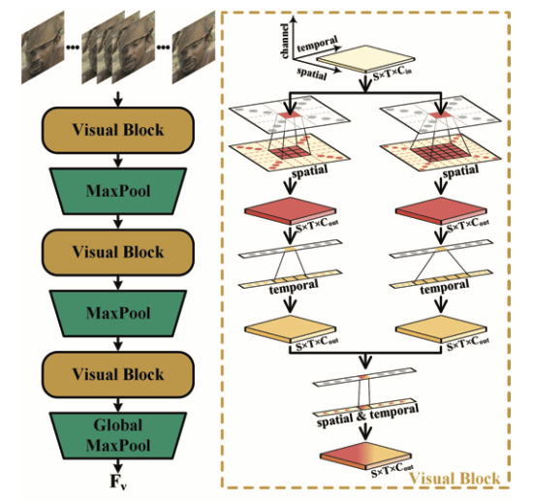
Proposed Method
Architecture of visual feature encoder
Source: J. Liao et al., "A Light Weight Model for Active Speaker Detection," 2023 IEEE/CVF Conference on Computer Vision and Pattern Recognition (CVPR), Vancouver, BC, Canada, 2023, pp. 22932-22941
Notes:
FLOPs：注意s小写，是floating point operations的缩写（s表复数），意指浮点运算数，理解为计算量。可以用来衡量算法/模型的复杂度。

Slide 20
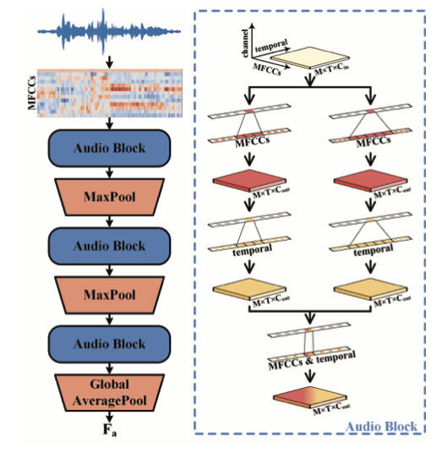
Proposed Method
Architecture of audio feature encoder
Source: J. Liao et al., "A Light Weight Model for Active Speaker Detection," 2023 IEEE/CVF Conference on Computer Vision and Pattern Recognition (CVPR), Vancouver, BC, Canada, 2023, pp. 22932-22941
Notes:
FLOPs：注意s小写，是floating point operations的缩写（s表复数），意指浮点运算数，理解为计算量。可以用来衡量算法/模型的复杂度。

Slide 21
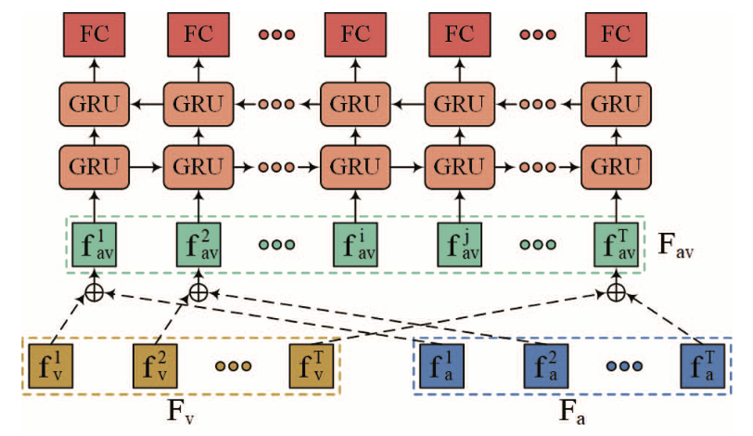
Proposed Method
Architecture of the detector
Source: J. Liao et al., "A Light Weight Model for Active Speaker Detection," 2023 IEEE/CVF Conference on Computer Vision and Pattern Recognition (CVPR), Vancouver, BC, Canada, 2023, pp. 22932-22941
Notes:
Architecture of the detector. fv, fa, and fav represent
the visual features, audio features, and multi-modal features of the ith frame of the candidate sequence, respectively.

Slide 22
Outline
Introduction
Proposed Method
Expect Result
Summary

Slide 23
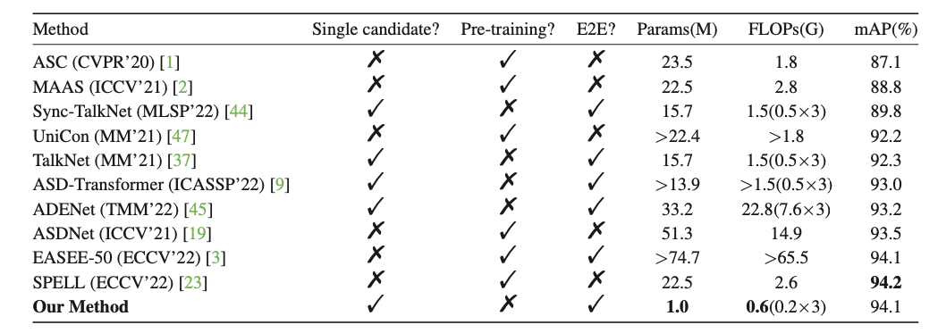
Expect Result
Performance comparison for methods on the validation set of the AVA-ActiveSpeaker dataset
Source: J. Liao et al., "A Light Weight Model for Active Speaker Detection," 2023 IEEE/CVF Conference on Computer Vision and Pattern Recognition (CVPR), Vancouver, BC, Canada, 2023, pp. 22932-22941
Notes:
作者的方法和其他10種方法的效能在驗證集上的比較：
比較六個點，後三者包括模型權重參數的數量，單位是用百萬、模型複雜度FLOPs (floating point operations)，單位是Giga，和mAP (mean Average Precision)
作者的方法在準確度上是和State of the art 是可以比擬的，在模型參數上，和SPELL在2022 ECCV所提出的方法相較，少了20倍
FLOPs：注意s小写，是floating point operations的缩写（s表复数），意指浮点运算数，理解为计算量。可以用来衡量算法/模型的复杂度。

Slide 24
Expect Result
Impact of the number of frames on the detection speed
Source: J. Liao et al., "A Light Weight Model for Active Speaker Detection," 2023 IEEE/CVF Conference on Computer Vision and Pattern Recognition (CVPR), Vancouver, BC, Canada, 2023, pp. 22932-22941
Notes:
Excluding data preprocessing, the proposed framework takes 96.04ms to infer 1000 frames
(about 40 seconds) of video on an NVIDIA RTX 3090 GPU, whereas the EASEE-50 [3] takes 2068.95ms for the audio- visual encoder portion alone.
This indi- cates that the proposed active speaker detection method not only meets the real-time detection requirements under dif- ferent input lengths, but also has a higher detection speed compared with the state-of-the-art end-to-end method [3].

Slide 25
Expect Result: Qualitative Analysis
Performance breakdown
??? X ??? pixels
Source: J. Liao et al., "A Light Weight Model for Active Speaker Detection," 2023 IEEE/CVF Conference on Computer Vision and Pattern Recognition (CVPR), Vancouver, BC, Canada, 2023, pp. 22932-22941
Notes:
FLOPs：注意s小写，是floating point operations的缩写（s表复数），意指浮点运算数，理解为计算量。可以用来衡量算法/模型的复杂度。

Slide 26
Outline
Introduction
Proposed Method
Expect Result
Summary

Slide 27
Summary
(6 points)
Purpose:
To develop an Active Speaker Detection System
Method:
Nvidia Jetson Nano Developer Kit 2GB
Visual Feature Encoder, Audio Feature Encoder, Detector
Expect Result:
Show active speaker with bounding box in every frame

Slide 28
Reference
[1] J. Liao et al., "A Light Weight Model for Active Speaker Detection," 2023 IEEE/CVF Conference on Computer Vision and Pattern Recognition (CVPR), Vancouver, BC, Canada, 2023, pp. 22932-22941

Slide 29
Thanks for listening!
DC & CV Lab. CSIE NTU

